Slide 1
Full Stack Web Development
Twitter Bootstrap / Getting Started

Slide 2
What Is Bootstrap?
Twitter Bootstrap is a front-end framework for faster and easier web development
It includes HTML & CSS templates & components for things like typography, buttons, menus, tables and lists
It also includes JavaScript widgets like modals, dropdowns, carousels and accordions

Slide 3
What can I use Bootstrap With?
Static Websites – HTML4, HTML5, XHTML
Frontend Applications – JavaScript, JQuery, Angular, React.js
Backend Server-Side Applications – Node.js, PHP, Ruby on Rails
Mobile & Hybrid Applications
Anything With An Interface

Slide 4
Reasons To Use Bootstrap
Easy To Use
Save Time
Responsive Layout
Mobile First Approach
Browser Compatability

Slide 5
Custom Elements
Typography
Forms
Tables
Buttons
Images
Bootstrap has classes and snippets to easily make your HTML elements look much cleaner and more stylish

Slide 6
CSS Components
Glyphicons
Dropdowns
Button Groups
Navbar
Breadcrumbs
Labels
Badges
Alerts
Jumbotron
Progress Bars
Media Objects
List Group
Panels
Wells
Input Groups

Slide 7
JavaScript Widgets
Modal
Dropdown
Tabs
Tooltip
Popover
Alert
Carousel / Slider
Bootstrap uses over a dozen custom JavaScript/JQuery plugins that can be used by simply including JQuery and the bootstrap.js file

Slide 8
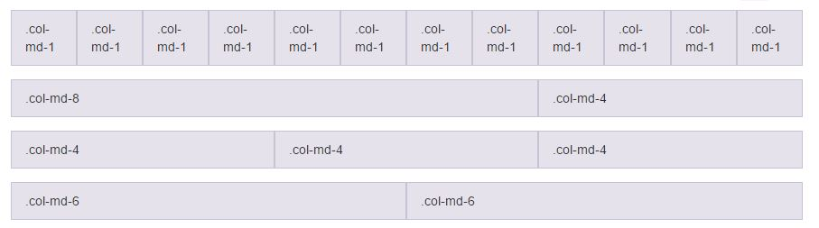
Grid System
Bootstrap includes a 12 column responsive, mobile-first fluid grid system which uses pre-defined classes and easy layout options

Slide 9
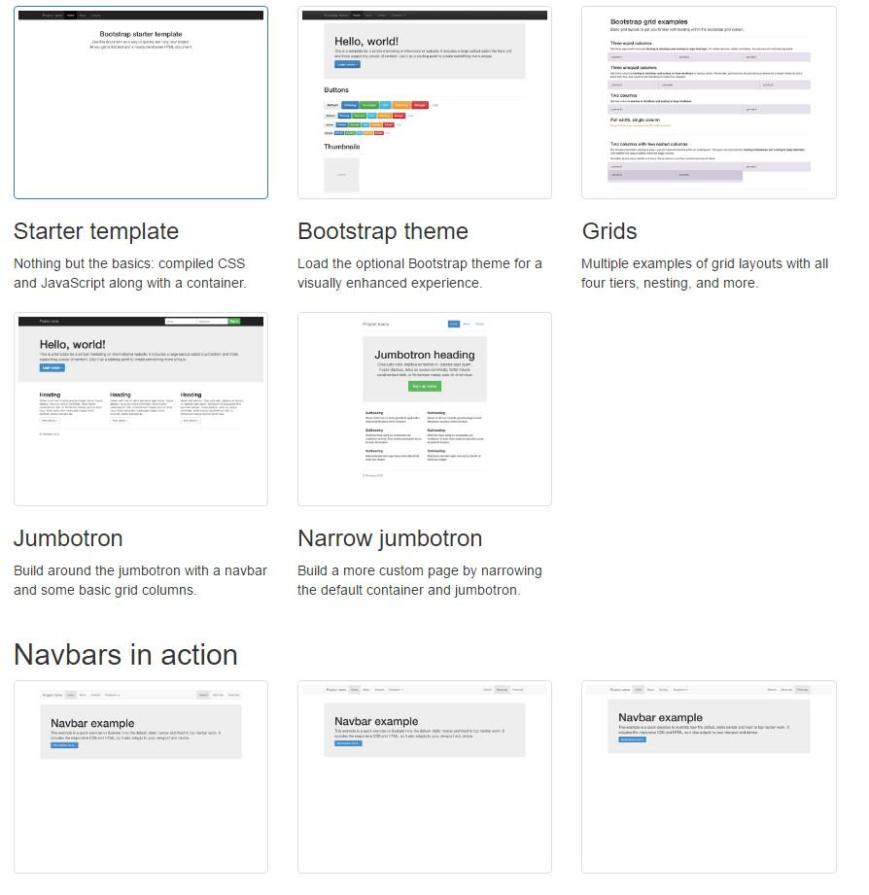
Templates
Ready-made templates and boilerplates for fast development and prototyping

Slide 10


